Slide 1
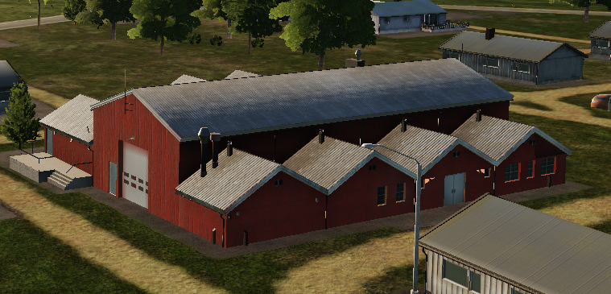
 | 500 IBS | 1000 IBS | 2000 IBS
1x Bomb
2x Bombs
4x Bombs

Slide 2
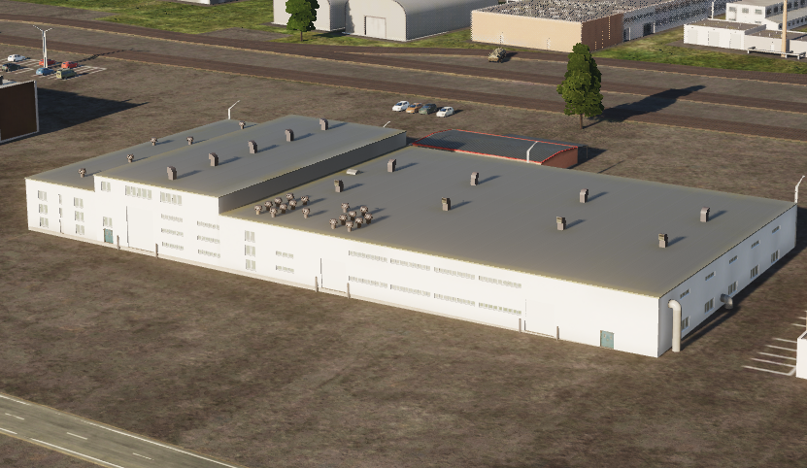
 | 500 IBS | 1000 IBS | 2000 IBS
1x Bomb
2x Bombs
4x Bombs
 | 500 IBS | 1000 IBS | 2000 IBS
1x Bomb
2x Bombs
4x Bombs

Slide 3
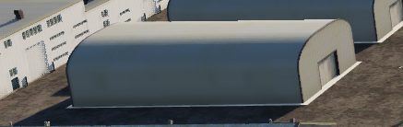
 | 500 IBS | 1000 IBS | 2000 IBS
1x Bomb
2x Bombs
4x Bombs

Slide 4
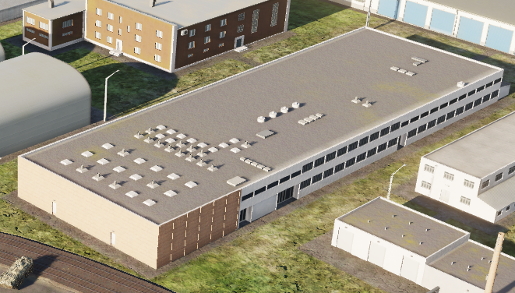
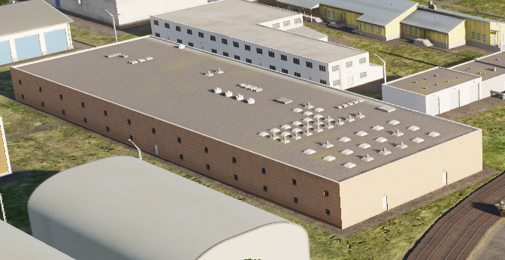
 | 500 IBS | 1000 IBS | 2000 IBS
1x Bomb
2x Bombs
4x Bombs

Slide 5
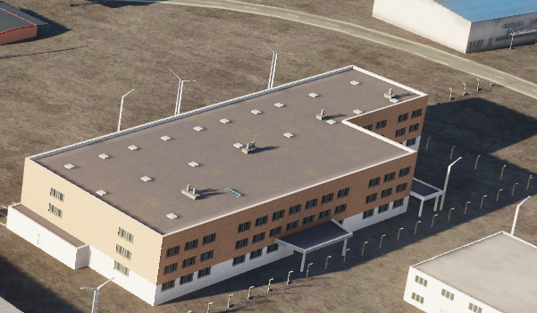
 | 500 IBS | 1000 IBS | 2000 IBS
1x Bomb
2x Bombs
4x Bombs

Slide 6
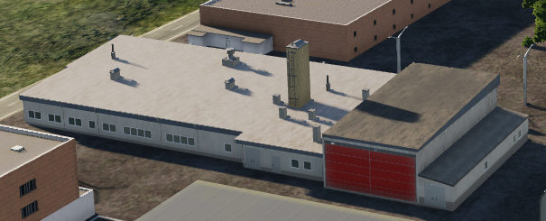
 | 500 IBS | 1000 IBS | 2000 IBS
1x Bomb
2x Bombs
4x Bombs

Slide 7
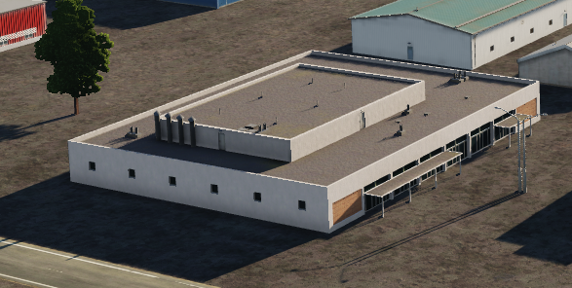
 | 500 IBS | 1000 IBS | 2000 IBS
1x Bomb
2x Bombs
4x Bombs

Slide 8
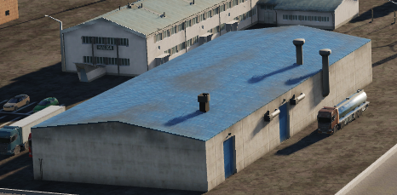
 | 500 IBS | 1000 IBS | 2000 IBS
1x Bomb
2x Bombs
4x Bombs

Slide 9
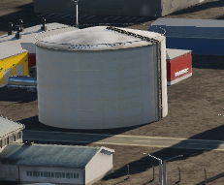
 | 500 IBS | 1000 IBS | 2000 IBS
1x Bomb
2x Bombs
4x Bombs

Slide 10
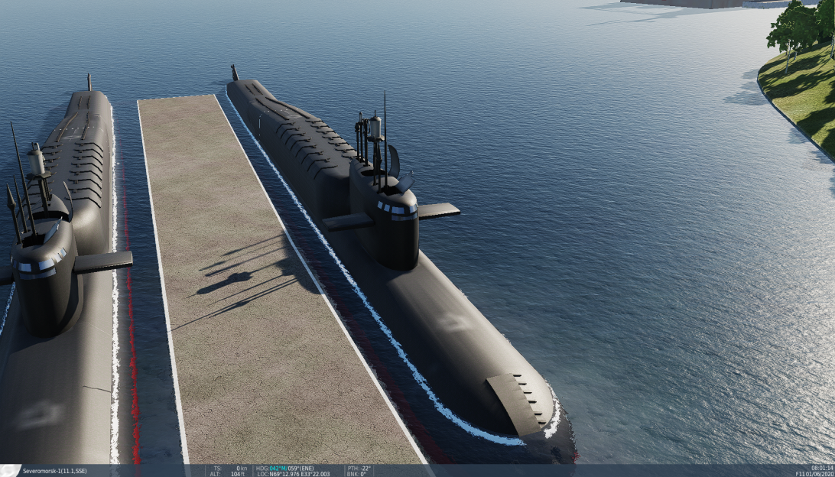
 | 500 IBS | 1000 IBS | 2000 IBS
1x Bomb
2x Bombs
4x Bombs
NOTE: Also destructable with 20mm cannon

Slide 11
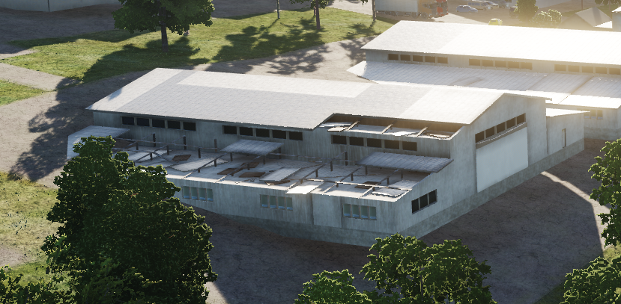
 | 500 IBS | 1000 IBS | 2000 IBS
1x Bomb
2x Bombs
4x Bombs
INDESTRUCTABLE

Slide 12
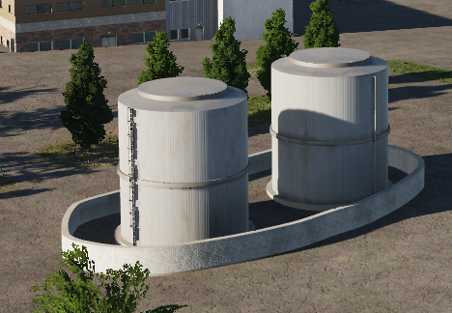
 | 500 IBS | 1000 IBS | 2000 IBS
1x Bomb
2x Bombs
4x Bombs

Slide 13
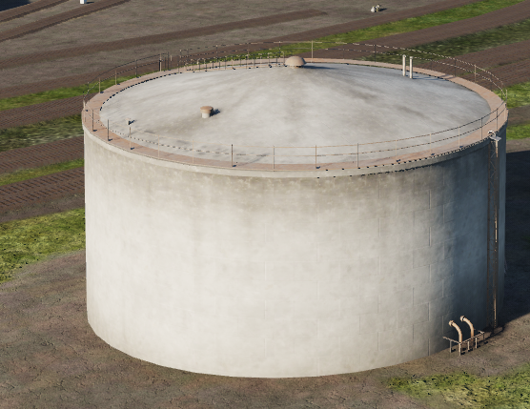
 | 500 IBS | 1000 IBS | 2000 IBS
1x Bomb
2x Bombs
4x Bombs

Slide 14
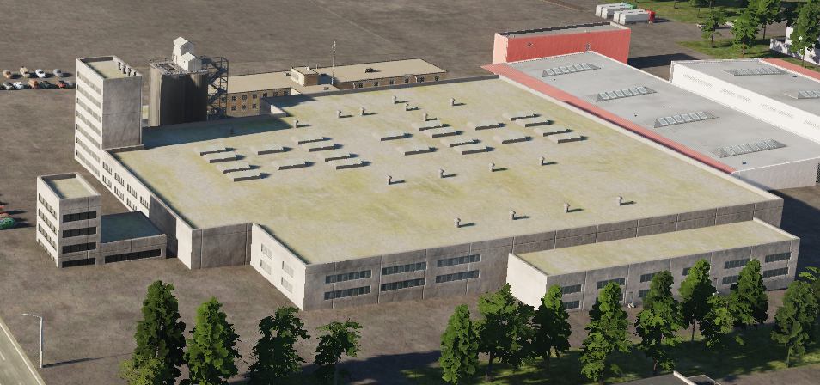
 | 500 IBS | 1000 IBS | 2000 IBS
1x Bomb
2x Bombs
4x Bombs

Slide 15
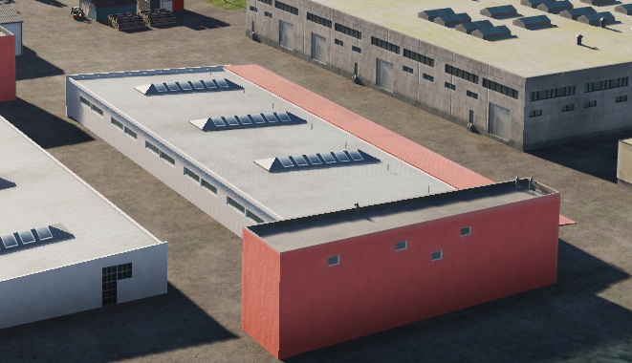
 | 500 IBS | 1000 IBS | 2000 IBS
1x Bomb
2x Bombs
4x Bombs

Slide 16
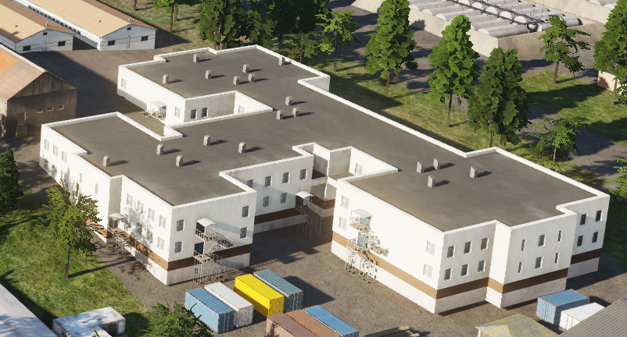
 | 500 IBS | 1000 IBS | 2000 IBS
1x Bomb
2x Bombs
4x Bombs

Slide 17
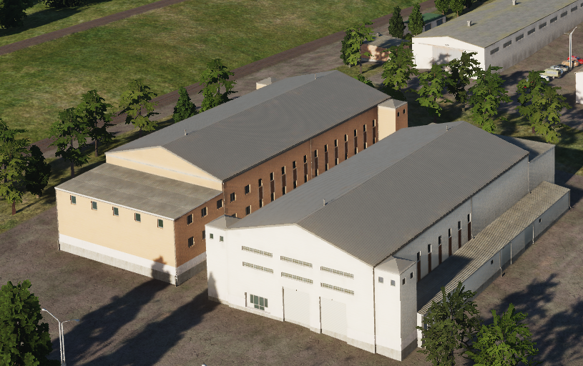
 | 500 IBS | 1000 IBS | 2000 IBS
1x Bomb
2x Bombs
4x Bombs
Same building, just different colors

Slide 18
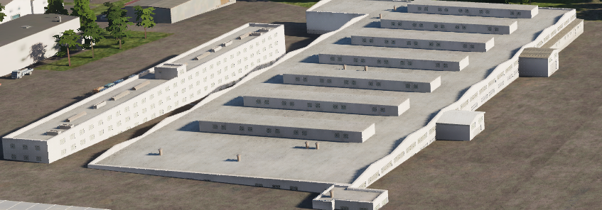
 | 500 IBS | 1000 IBS | 2000 IBS
1x Bomb
2x Bombs
4x Bombs
INDESTRUCTABLE

Slide 19
 | 500 IBS | 1000 IBS | 2000 IBS
1x Bomb
2x Bombs
4x Bombs

